Slide 1

BASICS OF IT

Slide 2
What is Computer?
Computer is an electronic device where it is combination of Software's and Hardware’s.
What is Software’s?
It is meant by set of programs to perform a particular task requested by user.
What is meant by Programs?
It is set of instructions for Hardware's and Software’s.

Slide 3
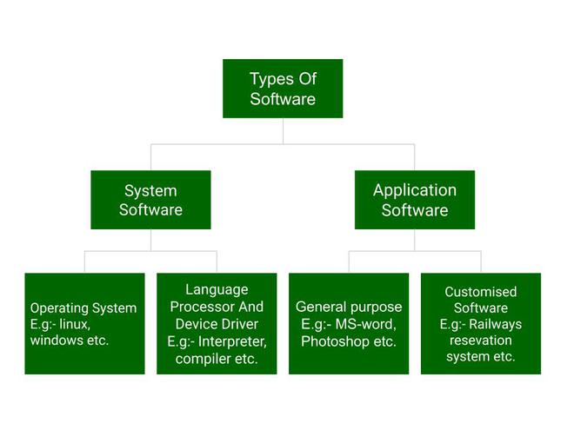
TYPES OF SOFTWARE’S

Slide 4

IP ADDRESS
An IP address is a unique address that identifies a device on the internet or a local network.
IP stands for "Internet Protocol," which is the set of rules governing the format of data sent via the internet or local network.

Slide 5
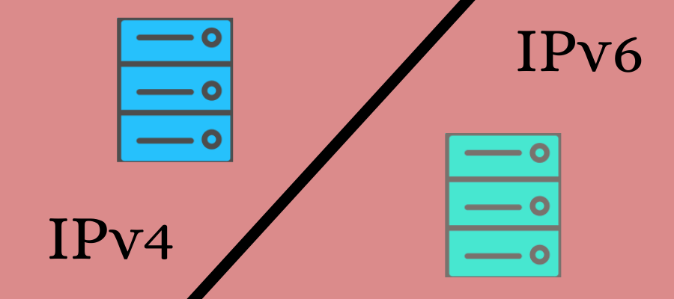
DIFFERENT VERSIONS OF IP ADDRESS
There are two types of IP address Version’s: -

Slide 6
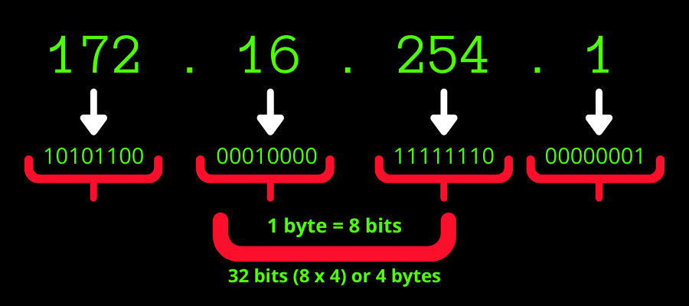
IPV4 ADDRESS
The original IP version deployed in the Advanced Research Projects Agency Network (ARPANET) for the first time in 1983 was IPv4. It is used widely in many corporations.
IPv4 represents an IP address in the form of a 32-bit number, consisting of 4 numbers separated by periods.
As each of the 4 numbers in an IPv4 address ranges from 0-255.

Slide 7
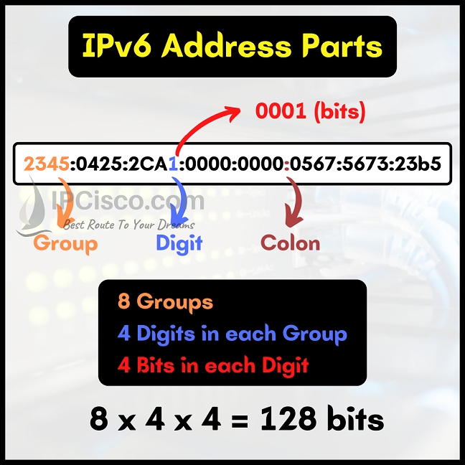
IPV6 ADDRESS
They eventually redesigned the IP as IPv6 in 1995. It went through a series of testing until the 2000s when its commercial deployment began.
In IPv6, the address space was increased to 128 bits or 16 octets. IPv6 is represented by 8 sets of 4 hexadecimal digits, where each number set is separated with the help of a colon and may contain letters and digits

Slide 8
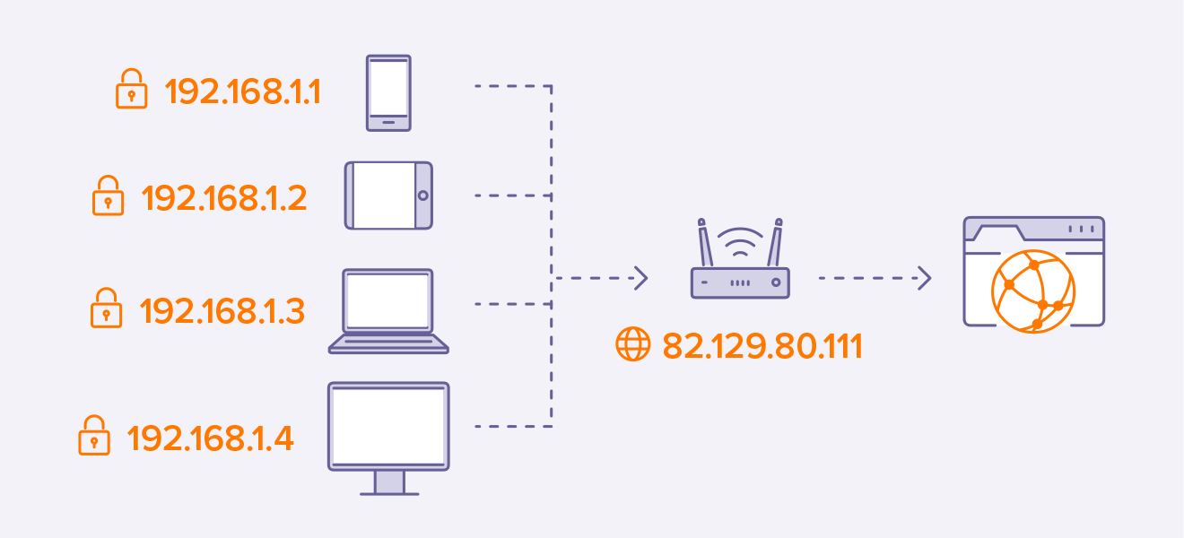
TYPES OF IP ADDRESS
Public IP Address
A unique numeric code never reused by other devices used for communicating outside your private network, over the internet.
Private IP Address
A private IP address is used within a private network to connect securely to other devices within that same network.
Each device within the same network has a unique private IP address.

Slide 9
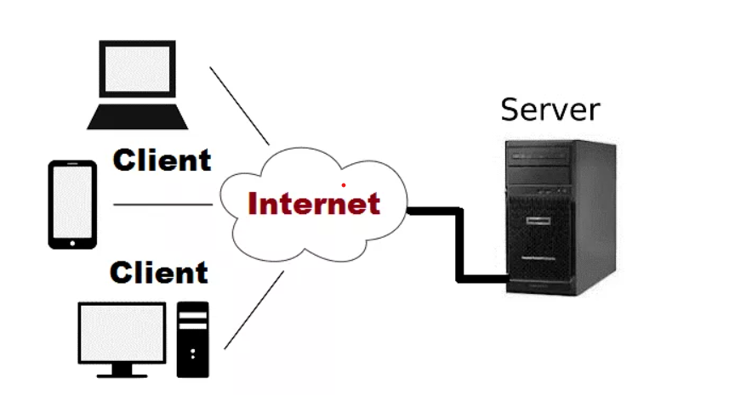
TYPES OF CLIENT – SERVER ARCHITECTURES
Client – Server Architecture or 2 tier architecture
Client-Server Architecture is a computing model in which the server hosts, delivers and manages most of the resources and services obtained by the client.
Fig:- Client – Server Architecture or 2-Tier Architecture

Slide 10
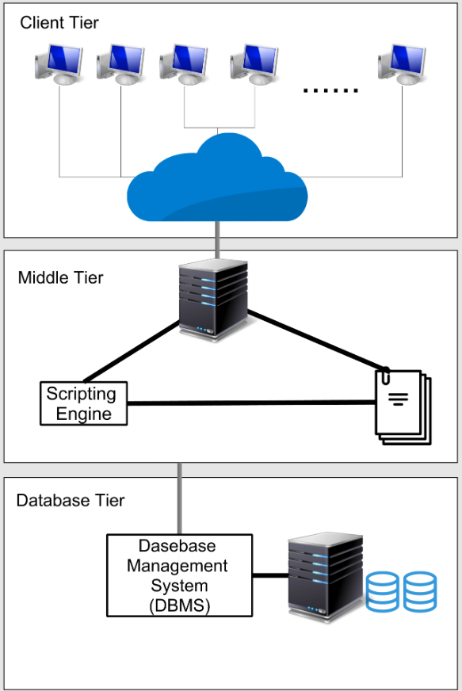
3-Tier Architecture
In 3 tier architecture there is an intermediate level called middleware system.
This middleware system divided in to two parts
a) Web server for presentation purpose for the client.
b) Application server for whose task is to provide the requested resources, but validating the resource is available/correct in the main server and perform all backend tasks.

Slide 11
N-Tier Architecture
N-tier architecture is also called multi-tier architecture because the software is engineered to have the processing, data management, and presentation functions physically and logically separated.
That means that these different functions are hosted on several machines or clusters, ensuring that services are provided without resources being shared and, as such, these services are delivered at top capacity.

Slide 12
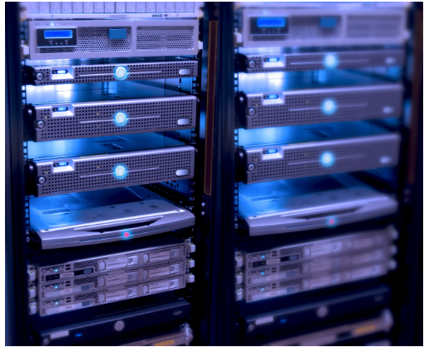
SERVER
A server is a computer or system that provides resources, data, services, or programs to other computers, known as clients, over a network.
Fig: - Server’s In Datacentres

Slide 13
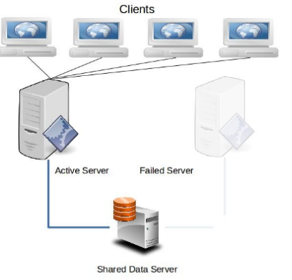
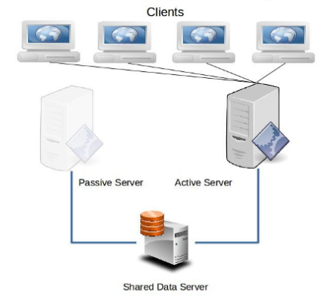
TYPES OF HIGH AVAILABILITY
Active-Passive High Availability
The passive (failover) server serves as a backup that's ready to take over as soon as the active (primary) server gets disconnected or is unable to serve, an active-passive failover for when a node fails.

Slide 14
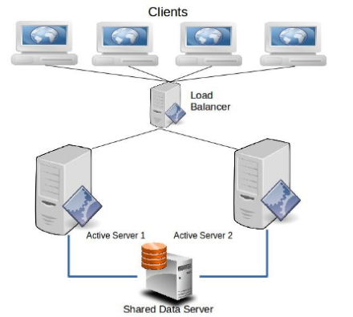
Active – Active High Availability
An active-active cluster is typically made up of at least two nodes, both actively running the same kind of service simultaneously

Slide 15
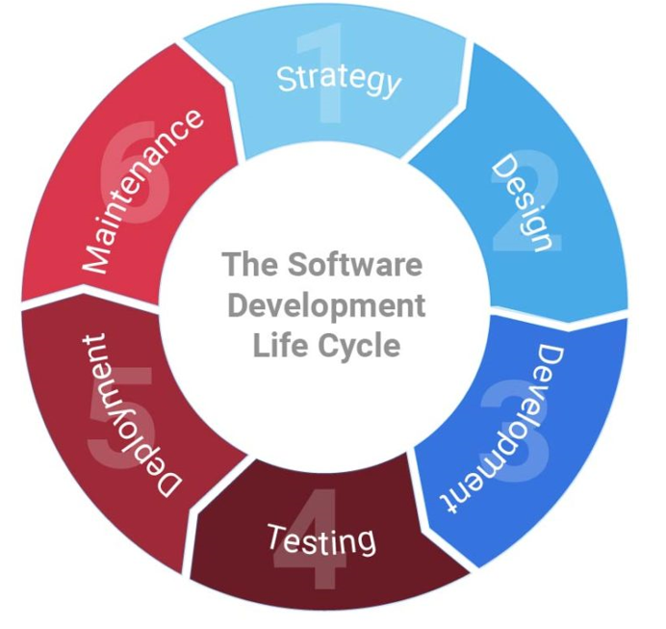
SDLC PROCESS
SDLC is a process followed for a software project, within a software organization. It consists of a detailed plan describing how to develop, maintain, replace and alter or enhance specific software.
The life cycle defines a methodology for improving the quality of software and the overall development process.

Slide 16
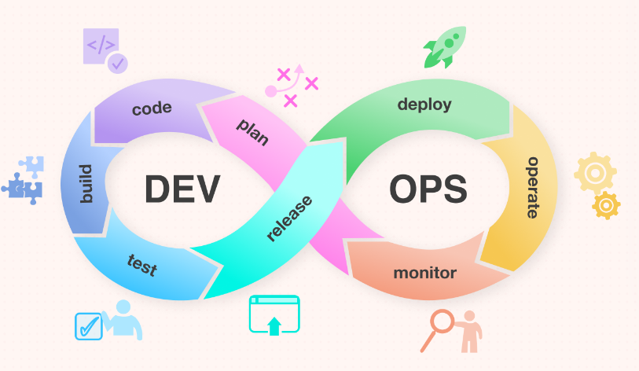
Devops Lifecycle
The DevOps Lifecycle is a series of development stages that guide everyone as efficiently as possible through the end-to-end process of product development. All of these components of the DevOps lifecycle is necessary to take the maximum leverage of the DevOps methodology.

Slide 17


